Slide 1


Mutual Fund Analysis Dashboard
Power BI Project Presentation
Shiv Rohit Mehra

Slide 2

Mutual Fund Analysis Dashboard (India 2023)
Author: Shiv Rohit Mehra
Dataset Source: https://www.kaggle.com/datasets/ashishraut64/mutual-funds-india

Slide 3

Project Objective
Analyze mutual fund performance in the year 2023 in India using Power BI and Excel to identify high-performing funds, category trends, and investor-friendly investment opportunities.

Slide 4

Agenda
Executive summary
Data snapshot
Page 1 Dashboard Overview
Page 2 Performance Analysis
Key calculated measures and DAX
Top findings from the two pages
Recommendations and next steps
Appendix: data dictionary and DAX snippets

Slide 5
Data Snapshot
Columns available
Scheme; Category;
Type; Benchmark; Rating; Net Asset Value (NAV); CAGR 6M; CAGR 1Y; CAGR 3Y;
Min Investment; Expense Ratio; SIP Min Investment.
Data quality notes
Numeric conversions: ensured CAGR and Expense Ratio are numeric and percent formatted.
Row count: 2556

Slide 6
Derived Metrics Created
Performance Score: Combines short, mid, and long-term performance.
Return Stability:
Lower value = stable performance
Identify Consistent Performers
Momentum: Detect funds gaining momentum recently
Return Efficiency: Measure return generated per unit cost
Affordability Score: Find high return funds with low entry barrier.
Cost Category: Cost distribution visuals

Slide 7
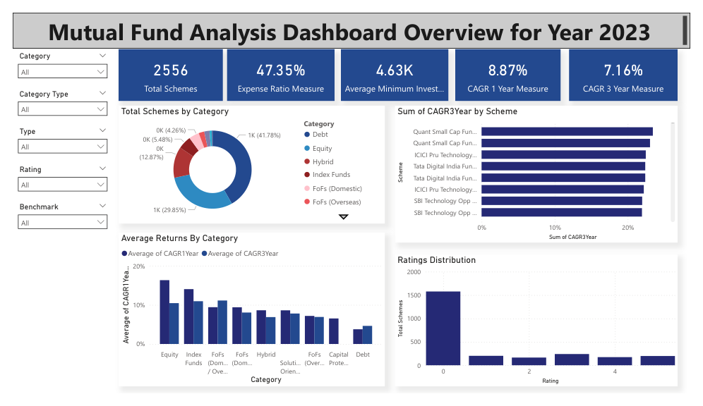
Dashboard Overview
KPI Cards
Total Schemes -2556
Average 1Y CAGR – 8.87%
Average 3Y CAGR – 7.16%
Average Expense Ratio – 47.35%
Average Minimum Investment – 4.63K

Slide 8
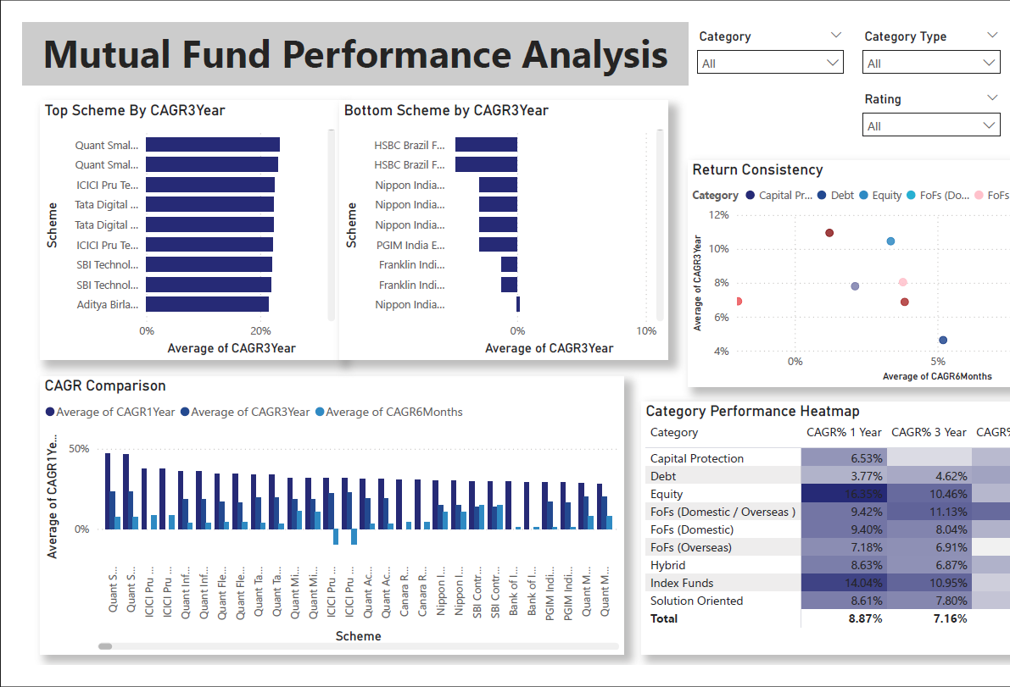
Scatter Plot shows that Equity & Index Funds showed Stable growth between short and long term, But Debt Funds had short term momentum and fell off in the long term.
While FoFs Overseas were not doing good in short term but did well long term. FoFs Domestic/Overseas performed the best in short term and long term and were very stable as well

Slide 9
Key Calculated Measures and DAX
Performance Score
Performance Score = (0.5 × [CAGR 3Y]) + (0.3 × [CAGR 1Y]) + (0.2 × [CAGR 6M])
Stability Score
Stability = ABS([CAGR 6M] − [CAGR 3Y]) (lower = more stable)
Return Efficiency
Return Efficiency = [CAGR 3Y] / [Expense Ratio]
Affordability Score
Affordability = [CAGR 3Y] / [Min Investment]

Slide 10
Top Findings
Top 3 funds by Performance Score
Quant Small Cap Fund (IDCW);
Quant Small Cap Fund (G);
Quant Mid Cap Fund (IDCW);
Most stable funds (lowest Stability Score)
DSP Liquidity Fund-Reg(G) score- 0.01;
Bottom 3 Funds By CAGR 3 years
HSBC Brazil Fund, Nippon India Strategic debt
Category winners by avg 3Y CAGR
FoFs (Domestic/Overseas) leads; Index Funds trails

Slide 11
Recommendations
Investor recommendations
Long term shortlist: CAGR 3Y > 10% AND Expense Ratio < 1% AND Rating ≥ 4.
ICICI Pru S&P BSE Sensex Index Fund
HDFC Index Fund S&P BSE Sensex
UTI Nifty 50 Index Fund - Reg

Slide 12
Appendix Data Dictionary
Data dictionary
Scheme: Fund name
Category: Equity / Debt / Hybrid etc.
Type: Growth / Dividend / Direct / Regular
Benchmark: Index name used for comparison
Rating: Numeric rating (1–5)
NAV: Net Asset Value in INR
CAGR 6M/1Y/3Y: Compound annualized returns for periods
Min Investment: Minimum lump sum investment in INR
Expense Ratio: Annual expense percentage
SIP Min Investment: Minimum SIP amount in INR

